Slide 1
Employee Leave Prediction
STAT4011 Project 2 Group 8
1155143605 Li SHENGWEI
1155116154 CHEONG Euikyun
1155158054 LUI Chak Sum
1155158643 CHAU Ka Yan 1155142918 HO Tsz Hin 1155158385 WONG Tuen Hung

Slide 2
Table of contents
01
02
03
04
05
06
Introduction
Data Visualization
Data Preparation
Can we predict employee leave?
Any trends in our data?
How to encode data?
Model Building
Model Evaluation
Conclusion
Different models for our problem
Which model gives the best performance?
How to apply our model?

Slide 3
01
Introduction
Presenter: Li SHENGWEI, George

Slide 4

Problem interest
Talent Attrition
Develop a solid organizational culture and strong value
Applicable training opportunities
Better working environment
Clear career advancement
More welfare
1.?
​Ott, D. L., Tolentino, J. L., & Michailova, S. (2018).
2.Effective talent retention approaches
3.Reduce the employee's loss rate

Slide 5
Data Set
Data resource: Kaggle(Employee dataset)
Variables | Content of variables
Education | Bachelors, Master, Phd
Joining Year | 2012 to 2018
City | Pune, Bangalore ,New Delhi ...
Payment Tier | 1,2,3
Age | 22 to 41
Gender | Male and Female
Ever Benched | 1,0
Experience In Current Domain | 0 to 7 years
Outcome Variable
Leave or Not
4653 Data and 9 variables
Notes:
Here is the results for rf without hyperparameter tuning.

Slide 6
Purpose of Analysis
From previous analysis in Kaggle (Employee_Attration_LogisticRegression) ,
the analyst only use Logistic regression model with low accuracy(0.59) so we would like to apply more machine learning model to this case.
1. Identify potential attrition cases
2. Determine the key factors influencing talent attrition
3. Offer valuable insights to the company, proposing improved approaches for better employee retention.
https://www.kaggle.com/code/farhanizzaturrahman/employee-attration-logisticregression

Slide 7
Data Visualization
02
Presenter: Lui Chak Sum, Sam
Notes:
Thank you, George. I’m Lui Chak Sum, Sam, and now I will introduce the data visualization part.

Slide 8
What we want to observe?
The proportion of leaving and staying employees
Relationship between features and leaving status (Any trends?)
Notes:
In this section, we are trying to observe the information listed. So that we can understand our data more and have a preliminary answer for the most important factors of leaving status

Slide 9
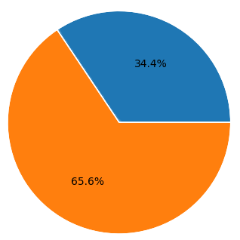
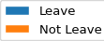
The proportion of leaving and staying employees
Imbalanced dataset
Classifers may perform poorly on the minority class
Notes:
In our dataset, leaving employees are the minority. This may reflect real-world situation. However, it is not a good situation for training machine learning classifier, because the classifier may

Slide 10
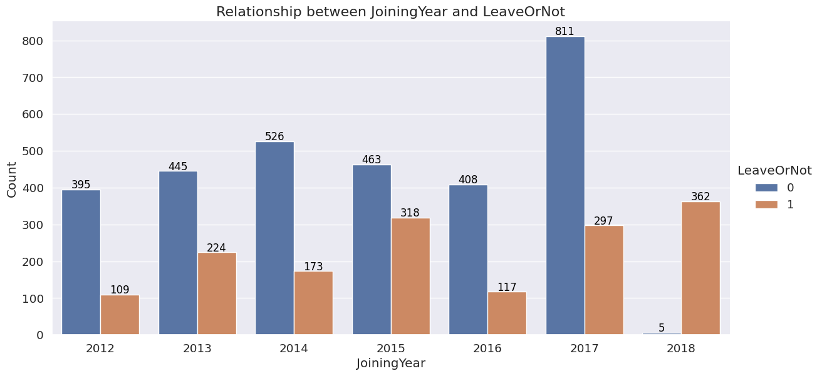
Joining Year vs Leave or Not
Highest proportion of leaving employees in 2018
Notes:
For the relationship between features and leaving status, we only introduce those with special trends. As you can see from this graph, employees joining in 2018 have a extremely high proportion of leaving employee, so this can be an important feature to determine whether the employees will leave or not

Slide 11
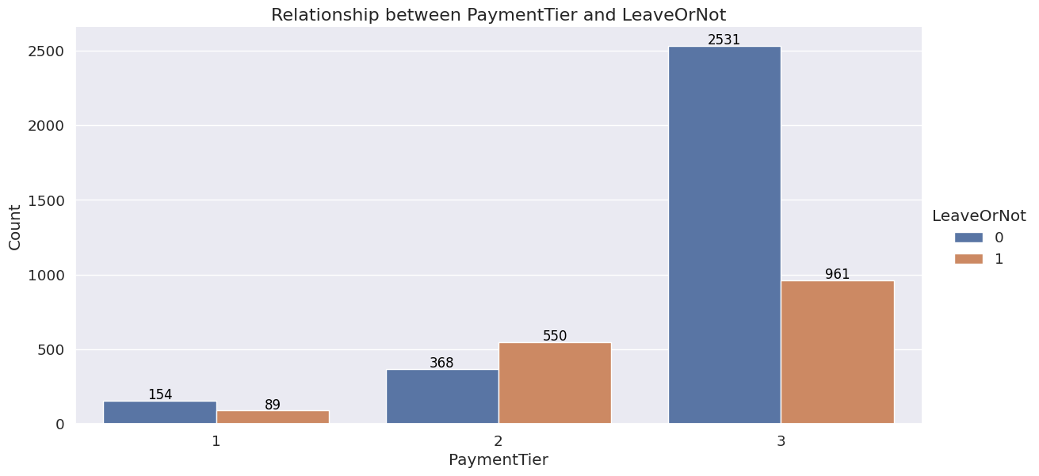
Payment Tier vs Leave or Not
Highest proportion of leaving employees with payment tier 2
Notes:
For the payment tier, employees with salary tier 2 have number of of leaving employees higher than that of staying.

Slide 12
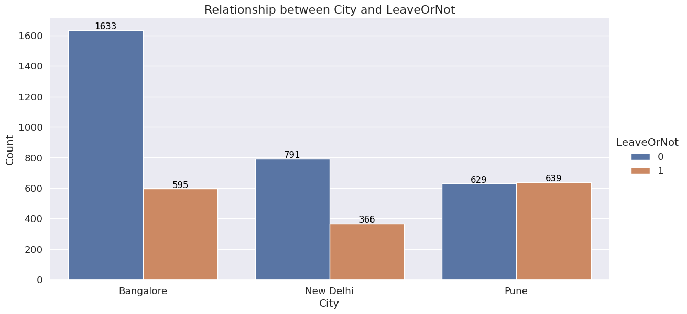
City vs Leave or Not
Highest proportion of leaving employees based or work in Pune
Notes:
Lastly, for City, employees based or work in Pune are more likely to leave the company.

Slide 13
Q: What are the most important factors to predict leaving status?
A: Graphically, joining year, payment tier ,and city.
Notes:
So up to this point, by observing the graph, we can simply say that joining year, payment tier and city can be the important factors, but to give a stronger evidence, we will try to evaluate by feature importance later. Now, Jacky will introduce the data preparation part.

Slide 14
03
Data Preparation
Presenter: Ho Tsz Hin, Jacky

Slide 15





Data Cleansing
Data cleansing refers to the process of detecting and correcting errors or inconsistencies in data sets to improve their quality.
Missing Data
Duplicated Data
Improperly formatted Data
Outlier Data

Slide 16

Result
 | JoiningYear | PaymentTier | Age | ExperienceInCurrentDomain | LeaveOrNot
count | 4653 | 4653 | 4653 | 4653 | 4653
Mean | 2015.0630 | 2.6983 | 29.3933 | 2.9057 | 0.3439
SD | 1.8634 | 0.5614 | 4.8261 | 1.5582 | 0.4750
Min | 2012 | 1 | 22 | 0 | 0
Max | 2018 | 3 | 41 | 7 | 1
No missing, outlier, duplicated and incorrected formatted data in our case!
Data Size: 4653

Slide 17



Data Preprocessing
Data preprocessing is the process of transforming cleaned data into an ideal format for deeper analysis and machine learning.
Encoding
Data Splitting

Slide 18
One - Hot Encoding
Motivation:
Many machine learning models prefer numeric value inputs to work and perform well
Education | Gender
Bachelors | Male
Bachelors | Female
Masters | Female
Masters | Male
Education_Bachelors | Education_Masters | Gender_Male | Gender_Female
1 | 0 | 1 | 0
1 | 0 | 0 | 1
0 | 1 | 0 | 1
0 | 1 | 1 | 0
1: Presence; 0: Absence

Slide 19
Result
 | Gender_Male | Gender_Female | Age | City_Bangalore | City_Pune | ...
0 | 1 | 0 | 34 | 1 | 0
1 | 1 | 0 | 28 | 0 | 1
2 | 0 | 1 | 38 | 0 | 0
3 | 0 | 1 | 27 | 1 | 0
4 | 1 | 0 | 24 | 0 | 1
All the categorical inputs have been converted to numerical !
Data Size: 4653
No. Variables : 30

Slide 20

Data Splitting
Full Data Size: 4653​
Full Dataset
80%
20%
Training Data Size: 3722
Test Data Size:
931​
Training set
Testing set
Train the model patterns and relationships in the data.
Test the trained model's accuracy on unseen data

Slide 21
Model Building
04
Presenter:
Chau Ka Yan, Connie – Decision Tree
Cheong Euikyun, Steven – Light GBM
Lui Chak Sum, Sam – Bagging
Wong Tuen Hung, Ivy – Random Forest
Notes:
Thank you, Jacky. I am Chau Ka Yan, Connie and now I will introduce the decision tree mode.

Slide 22
1. Decision tree
Predict value of target variables
Simple decision rules
Data features
Model Assumption
Features used for splitting nodes are independent of each other
Simple to build
Easy to understand
Notes:
The model is created by predicting the value of a target variable by learning simple decision rules inferred from the data features. Decision tree model assume that the features used for splitting nodes are independent of each other. This assumption ensures that each feature provides unique information to the decision-making process. The model is simple to build and the result of the model is highly intuitive therefore it is easy to understand.

Slide 23
1-1. Result without hyperparameter tuning
Accuracy
0.8400
Precision
0.7986
Recall
0.7165
F1_score
0.7553
Notes:
This is the result of the model. And to get a better result, we can tune and improve the model.

Slide 24
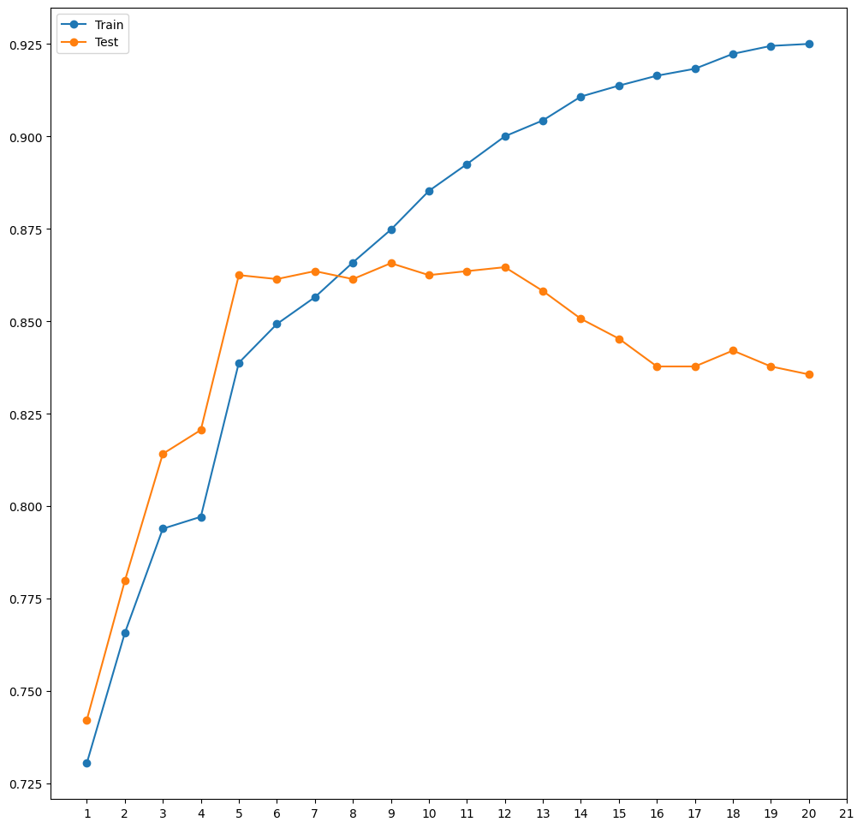
1-2. Decision tree with hyperparameter tuning
Parameter
max_depth : 9
Notes:
To improve the model, we evaluate the decision tree for each depth. As seen from the chart here, the max_depth=9 gives the best score for both testing and training data sets. Therefore, we use it in the tuned model.

Slide 25
1-2. Decision tree with hyperparameter tuning
 | Random State
 | 0 | 1 | 2 | 3 | 4 | 5 | 6 | 7 | 8 | 9 | Average
Accuracy | 0.8657 | 0.8657 | 0.8657 | 0.8657 | 0.8657 | 0.8668 | 0.8668 | 0.8668 | 0.8657 | 0.8668 | 0.8662
Precision | 0.8889 | 0.8889 | 0.8889 | 0.8889 | 0.8889 | 0.8893 | 0.8893 | 0.8893 | 0.8889 | 0.8893 | 0.8891
Recall | 0.6978 | 0.6978 | 0.6978 | 0.6978 | 0.6978 | 0.7009 | 0.7009 | 0.7009 | 0.6978 | 0.7009 | 0.6991
F1 score | 0.7818 | 0.7818 | 0.7818 | 0.7818 | 0.7818 | 0.7840 | 0.7840 | 0.7840 | 0.7818 | 0.7840 | 0.7827
Notes:
To increase the credibility, we calculate the results under different random state and take the average of result.

Slide 26
1-3. Result with hyperparameter tuning
Results (without tuning)
Results (with tuning, in average)
Accuracy: 0.8400
Accuracy: 0.8662
+ 0.0262
Precision: 0.7986
Precision: 0.8891
+ 0.0905
Recall: 0.7165
Recall: 0.6991
- 0.0174
F1_score: 0.7553
F1_score: 0.7827
+ 0.0274
Notes:
Now, let’s see the results before and after tuning. (Click) We can see the tuned model has increase in Accuracy , Precision and F1 score while the Recall score decreased.

Slide 27
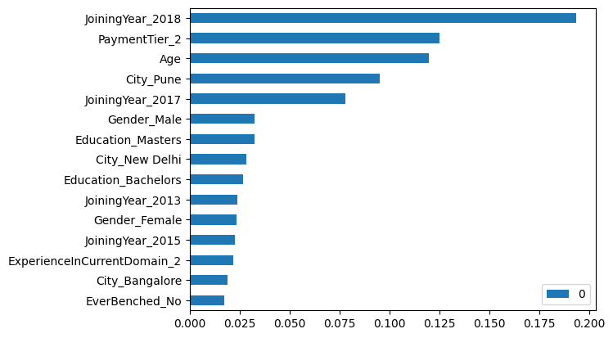
1-4. Feature Importance
Notes:
Next, for the feature importance of the model. The higher feature score means the feature is more important and with greater coverage. For example, joining year in 2018 is the most important and with largest coverage, therefore it is used in the first decision node. Now, Steven will introduce the LGBM model.

Slide 28
2. LGBM
Gradient Boosting Framework
Building Histogram-based Algorithms
Optimizations and Enhancements
Model Assumption
Increase time of fitting due to increased variables(one hot encoding)
Provide Better Speed and Efficiency
High Flexibility
Notes:
Thanks Connie. Hi. I'm CHEONG Euikyun, Steven. And I will talk about the Light gradient boosing machine model. LGBM starts with a basic model, like a decision tree or average target values, and iteratively improves it by building new trees to predict and correct the errors of the previous ones. It employs histogram-based algorithms to efficiently manage data, grouping feature values into bins to simplify and speed up computations. The algorithm uniquely grows trees leaf-wise, focusing on the most significant splits, which enhances its performance, especially on large datasets. Moreover, LGBM optimizes memory usage and speed through multiple parameters.

Slide 29
2-1. Result without hyperparameter tuning
Accuracy
0.8711
Precision
0.8910
Recall
0.7133
F1_score
0.7924
Notes:
This is the result without hyperparameter tuning.

Slide 30
2-2. LGBM with hyperparameter tuning
GridSearchCV parameters
N_estimators | 100 | 500 | 1000 | 2000
Learning_rate | 0.001 | 0.01 | 0.1 | 0.3
Max_depth | -1 | 5 | 10 | 15
Num_leaves | 31 | 127 | 255 | 511
Min_child_samples | 5 | 20 | 50 | 100
Parameters (after tuning)
N_estimators : 2000
Learning_rate : 0.001
Max_depth : -1
Num_leaves : 31
Min_child_samples :5
Notes:
To enhance the model, we used gridsearch method to find the best parameter setting in the lgbmmodel. This table describes the possible parameters for the model.
After the hyperparameter tuning process, we have finalized the best parameters for the lgbm model.

Slide 31
2-3. Result with hyperparameter tuning
Results (without tuning)
Results (with tuning, in average)
Accuracy: 0.8711
Accuracy: 0.8786
+ 0.0075
Precision: 0.8910
Precision: 0.9333
+ 0.0423
Recall: 0.7133
Recall: 0.6979
- 0.0154
F1_score: 0.7924
F1_score: 0.7986
+ 0.0062
Notes:
The result of the prediction based on the tuned model has increased the score of Accuracy, Precision, and F1-score. But it has decreased the Recall score.

Slide 32
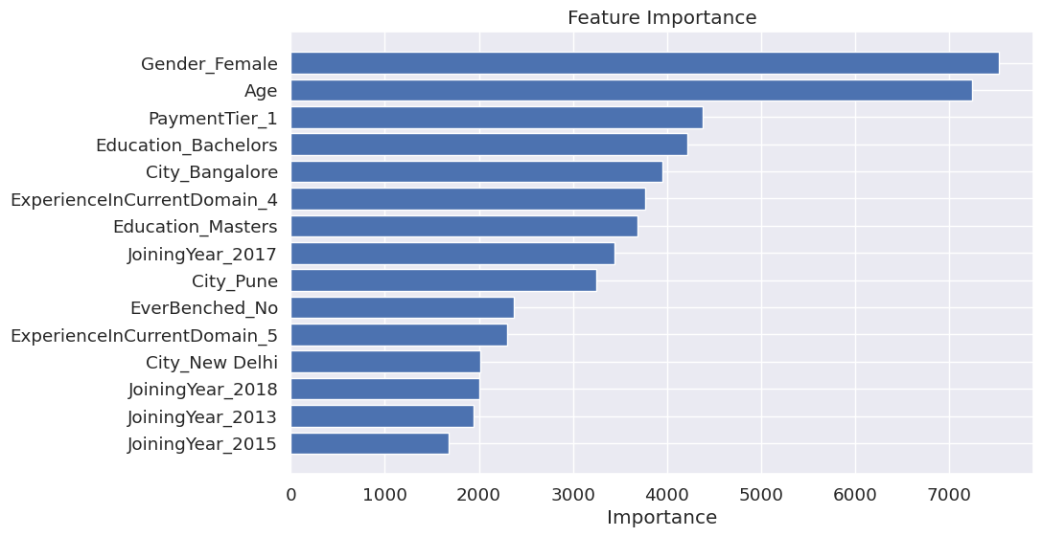
2-4. Feature Importance
Notes:
This is the assorted feature importances of tuned LGBM model. The top 3 important feature is Gender_female, Age, and PaymentTier1. Now, I'm going to pass to Sam for Bagging.

Slide 33
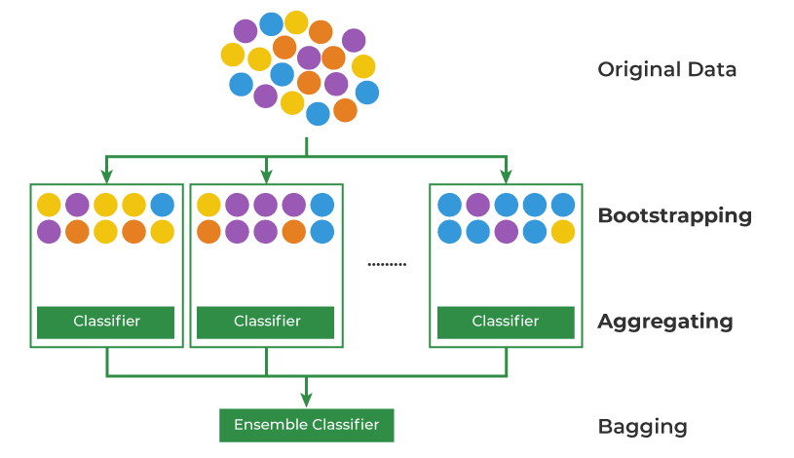
3. Bagging
Bagging
Decision Tree with bootstrap samples
Decision Tree
Model Assumption
Training data are independent and identically distributed
Increased stability
Can handle imbalanced data
Notes:
Thank you, Steven. From Light GBM, you can see that the recall didn't improve compared to decision tree, so we also tried bagging. Bagging doesn’t have much model assumption, but if the data are independent and identically distributed, the model can give more accurate prediction. We consider bagging because compared to dt, bagging is more stable because combining multiple trees make it less sensitive to small changes in the training data, and compared to Light GBM, bagging can handle imbalanced data well because it ensures that each model has exposure to both majority and minority classes by using bootstrap samples.

Slide 34
3-1. Result without hyperparameter tuning
Accuracy
0.8443
Precision
0.8034
Recall
0.7259
F1_score
0.7627
Notes:
Without hyperparameter tuning, we get a preliminary result first.

Slide 35
3-2. Bagging with hyperparameter tuning
GridSearchCV parameters
estimator | DecisionTreeClassifier(maxdepth=5) | DecisionTreeClassifier(maxdepth=7) | DecisionTreeClassifier(maxdepth=9)
n_estimators | 1000 | 1500 | 2000
max_samples | 0.5 | 0.7 | 0.9
max_features | 0.5 | 0.7 | 0.9
Parameters (after tuning)
estimator: DecisionTreeClassifier(max_depth=7)
n_estimators: 1000
max_samples: 0.5
max_features: 0.9
Notes:
Then, After the hyperparameter tuning process, we have finalized the best parameters for the bagging model.

Slide 36
3-2. Result with hyperparameter tuning
Results (without tuning)
Results (with tuning, in average)
Accuracy: 0.8443
Accuracy: 0.8789
+ 0.0346
Precision: 0.8034
Precision: 0.9171
+ 0.1137
Recall: 0.7259
Recall: 0.7134
- 0.0125
F1_score: 0.7627
F1_score: 0.8025
+ 0.0398
Notes:
Based on the parameter setting returned from grid search, we apply the tuned model ten times with 10 random seeds and get the average performance scores. Overall speaking, the Accuracy, Precision, and F1-score increased. But the Recall decreased. However, compare to decision tree and Light GBM, it still has a higher recall. As for the feature importance, since bagging used bootstrap sample, feature importance produced may not be valid, so we will not consider feature importance in this model.

Slide 37
4. Random Forest
Random Feature Selection
Draw random subsets of features
Bagging
Decision Tree with bootstrap samples
Decision Tree
Model Assumption
Non-formal distribution
No correlation between variables
Suitable for high-dimensional data
Lower risk of overfitting and better predictive performance
Notes:
Thank you, Sam. I am Wong Tuen Hung, Ivy. And now I will introduce the last model rf. Random Forest is actually a bagging algorithm, but different to regular bagging, rf only draw random subsets of features for each dt.
If the data are non-formal distributed, rf can give more accurate prediction. Also, if there is no correlation between variables, the model is more likely to have unbiased feature importance.
We consider this model because compare with decision tree, rf is more stable when dealing with high-dimensional data, and compared to LightGBM, random forest can lower the risk of overfitting because the random subset of features make the multiple decision trees are more independent to each other((because the multiple decision trees are trained on different random subsets of features, so they overfits differently, then the multiple overfitting classifiers are put together to reduce the overfitting)). This also is the reason why rf often have better predictive performance and shorter training time than bagging.

Slide 38
4-1. Result without hyperparameter tuning
Accuracy
0.8378
Precision
0.7911
Recall
0.7196
F1_score
0.7537
Notes:
Here is the results for rf without hyperparameter tuning.

Slide 39
4-2. Random Forest with hyperparameter tuning
GridSearchCV parameters
max_depth | 5 | 10 | 15
min_samples_leaf | 1 | 3 | 5
min_samples_split | 3 | 4 | 5
n_estimators | 1000 | 1500 | 2000
Parameters (after tuning)
max_depth: 10
min_samples_leaf: 3
min_samples_split: 3
n_estimators: 2000
Notes:
To enhance the model, we used gridsearch method to find the best parameter setting in the random forest model. ((This table describes the possible parameters for the model. ))
After the hyperparameter tuning process, we have finalized the best parameters for the random forest model.

Slide 40
4-2. Result with hyperparameter tuning
Results (without tuning)
Results (with tuning, in average)
Accuracy: 0.8378
Accuracy: 0.8760
+ 0.0382
Precision: 0.7911
Precision: 0.9360
+ 0.1449
Recall: 0.7196
Recall: 0.6875
- 0.0321
F1_score: 0.7537
F1_score: 0.7927
+ 0.0390
Notes:
Then, we apply the tuned model ten times and get the average performance scores. The result has increased the Accuracy, Precision, and F1-score. But decreased the Recall score. However, it has the highest precision score compared to other models.

Slide 41
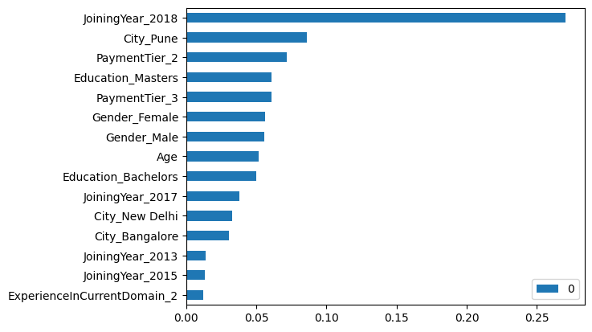
4-3. Feature Importance
Notes:
Last, we look for the feature importance. We can see that the top three features are joining year in 2018, employees based or work in Pune and salary tiers 2 (middle salary level), which is the same as what was observed in the graphs by Sam. Then, George will introduce the model evaluation.

Slide 42
05
Model Evaluation
Presenter: Li SHENGWEI, George

Slide 43

Models Performance
Results from 10 random seeds
Model after tunning | Average Accuracy | Average Precision | Average Recall | Average F1 Score | Average FPR
Decision Tree | 0.8662 | 0.8891 | 0.6991 | 0.7827 | 0.0459
LGBM | 0.8786 | 0.9333 | 0.6978 | 0.7986 | 0.0262
Bagging | 0.8789 | 0.9171 | 0.7134 | 0.8025 | 0.0339
Random Forest | 0.8760 | 0.9360 | 0.6875 | 0.7927 | 0.0248
1. Bagging outperform other three models in accuracy, recall and F1 score.
2. Random forest outperform other three models in precision and false positive rate
3. The difference(0.003) of accuracy is quite small between Bagging and Random forest
Notes:
Last, we look for the feature importance. We can see that the top three features are joining year in 2018, employees based or work in Pune and salary tiers 2, which is the same as what was observed in the graphs by Sam. Then, I will pass to George to introduce model evaluation part.

Slide 44
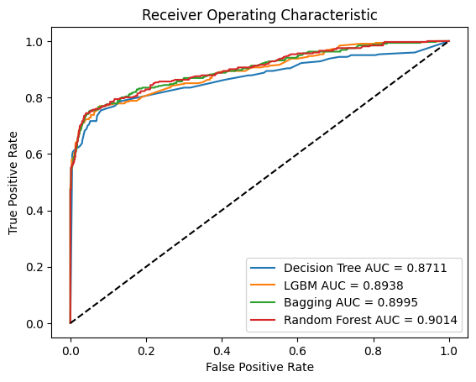
Optimal Classifier
ROC Curves for 4 models
1. The Random Forest model is preferred since it is the largest area under curve(AUC:0.9014) within four models.
2. Larger AUC presents the better performance of this model. (The perfect AUC = 1)
Notes:
Last, we look for the feature importance. We can see that the top three features are joining year in 2018, employees based or work in Pune and salary tiers 2, which is the same as what was observed in the graphs by Sam. Then, I will pass to George to introduce model evaluation part.

Slide 45
Conclusion
06
Presenter: Cheong Euikyun, Steven

Slide 46
6-1 . Best model and Features
The top 3 feature importance | Decision Tree | LGBM | Random Forest
1st | Joining Year_2018 | Gender_Female | Joining Year_2018
2nd | City_pune | Age | PaymentTier_2
3rd | PaymentTier_2 | PaymentTier_1 | City_pune
The features 'Joining Year_2018', 'City_pune', and 'PaymentTier_2' are consistently
significant factors across all three models.
Notes:
In our model analysis, three features stand out for their significant contributions to our predictions: 'Joining in 2018', 'Workers in the City of Pune', and 'Payment Tier 2'. Notably, we previously highlighted the data visualizations related to these features, underlining their relevance.
For the 'Joining in 2018' feature, an interesting pattern emerges. It appears that individuals who joined the company earlier are less likely to leave, in contrast to newer employees who might find more opportunities to exit. This insight suggests a strong connection between the duration of employment and employee retention.
Regarding 'Workers in Payment Tier 2', our data indicates a higher rate of departure compared to other tiers. This trend could be attributed to employees with more years of service, who might ponder more profoundly about their career paths. A lack of sufficient growth opportunities or challenges in their current roles may drive them to seek better prospects elsewhere.
Finally, the 'City of Pune' feature reveals the impact of regional factors on job stability. The likelihood of employees leaving their jobs in Pune might be influenced by various aspects, such as industry concentration, infrastructure issues, and the strength of local networks and communities. Understanding these regional dynamics is crucial for interpreting our model's predictions."

Slide 47
6-2 . Limitations
Variables
Education
Joining Year
City
Payment Tier
Age
Gender
Ever Benched
Experience In Current Domain
Limitation 1 :
Relatively few variables used in our machine learning project might affect the precision of our findings
Conclusion :
Breaking down payment tiers into finer levels can better reveal payment patterns.
Including variables like housing prices and transportation availability will also enhance our analysis.
Notes:
In this project, we thought that Relatively few variables used in our machine learning project might affect the precision of our findings
To deal with this, we thought some suggestion of further refining our variables, such as by breaking down payment tiers into more discrete levels to better understand payment behaviors and including more environmental variables such as like average housing prices and transportation facility availability, could significantly enhance the depth and relevance of our analysis.

Slide 48
6-2 . Limitations
Model | Average Accuracy | Average Precision | Average Recall | Average F1 Score | Average FPR
Decision Tree | 0.8662 | 0.8891 | 0.6991 | 0.7827 | 0.0459
LGBM | 0.8786 | 0.9333 | 0.6978 | 0.7986 | 0.0262
Bagging | 0.8789 | 0.9171 | 0.7134 | 0.8025 | 0.0339
Random Forest | 0.8760 | 0.9360 | 0.6875 | 0.7927 | 0.0248
Limitation 2:
Comparing with other models, recall scores are relatively small than other scores which can cause that our model does not screen out the true leave of employee.
Conclusion :
The related institution should count the number of employee leaves carefully.
Notes:
For our second limitations, we have found that comparing with other models, recall scores are relatively small than other scores which can cause that our model does not screen out the true leave of employee.

Slide 49
Thanks!
Do you have any questions?
STAT4011 Project 2 Group 8

Slide 50
Reference
Data
https://www.kaggle.com/datasets/tawfikelmetwally/employee-dataset/data
Powerpoint
https://slidesgo.com/theme/world-informatics-day?utm_source=whatsapp&utm_medium=social-organic&utm_campaign=template-whatsapp
Other Information
Ott, D. L., Tolentino, J. L., & Michailova, S. (2018). Effective talent retention approaches. Human resource management international digest, 26(7), 16-19.

